Slide 1
Political Transformation In The US:
Politics Matters

Slide 2
Timeline:
Laissez-Faire transition → Welfare State → transition → Neoliberalism
Pre-1930s 1930s 1940s-1970s 1970s 1980s-
State Type:
Classical Liberal Welfare/Keynes Neoliberal State
State State (distracted)
(involved)
Characteristics:
Free markets Mixed economy Free markets
Minimum Increasing Reduced/Limited
Government Government Government
Intervention Intervention/ Intervention
“protection” of business regulation of deregulation/
social and privatization
economic affairs

Slide 3
Classical Liberal (uninvolved) State: Pre-1930s
Defined:
  Government not involved in the lives of ordinary people.
Theory/Ideology:
  Laissez-faire.
State-Society Relations:
  Weak State; little government intervention in the lives of ordinary people.
Strategy:
    Free Markets.
    Pro-private property; minimal regulation of large business
Characteristics:
  Support for business: Property; Infrastructure; International.
  Repression of the Dangerous Classes: anti-union activities.
  Poor relief.
Transition
  Structure
  Threat from below

Slide 4
Welfare (involved) State: 1940s – 1970s:
Defined:
  Government involved in the lives of ordinary people.
Theory/Ideology:
  Keynesianism/social democracy.
State-Society Relations:
  Activist & Stronger State-weaker market society (New Political Compact).
Strategy:
  Welfare state.
  Mixed economy: Regulated Markets.
  Social programs/citizen wage.
Characteristics (New Political Compact):
  Class compromise
  Government as part of the solution.
  Support of Unions.
  Social Programs (Insurance; Public Assistance): Citizenship Rights.
  Support for Business.
Warfare.

Slide 5
Neoliberal (distracted) State: Post - 1980s
Defined:
  Government increasing distracted by a range of problems & less involved in lives of ordinary people.
Theory/Ideology:
  Neo-liberalism—Laissez-faire.
State-Society Relations:
  Shrinking state-Stronger market society;
Strategy:
  Deregulation & reduced regulatory oversight;
  Tax cuts—many global businesses paying zero taxes;
  Cut social programs;
  Anti-union policies;
  Free Markets: Capital, Trade, & Labor.
Characteristics:
  Government as the problem;
  Emphasis on property rights;
  Power shifted to capital from labor
  Emphasis on Individual responsibility.

Slide 6
Transition to Neoliberalism:
Structure:
Globalization and crisis of the 1970s (rise of global competition)
Agency:
Private capital/business, sections of the middle class, and social conservatives

Slide 7
Conditions for the Shift:
Coalitional Breakdown: Growing disagreement over how best to solve the most pressing social problems;
New Social Movements: The emergence of New Social Movements—e.g., environmental, racial, ethnic, gender and sexuality—added often conflicting pressures on the state. Whereas from the 1930s through the 1970s there was a general agreed upon dividing political line between Democrats & Republicans, today these coalitions are more fragmented by various “identity” based movements.
New Right: growth of the new right coalition; a coalition of politicians, big business; white working-class voters and social conservatives—Christian Right committed to undo the welfare state.
Moral Conflicts: Rise of the social conservatives, moral majority and Christian Coalition raising the issue of declining morality & traditional values; increased “welfare dependency”; and the need for greater individual responsibility.
Contradiction: Within the context of neoliberalism growing tensions in what Rubin calls market freedom versus citizen rights that bubbled over in the 1980s.

Slide 8
Conditions Cont.
Technology: Complements market-based globalization and power shift away from the State, exacerbates existing problems and/or creates new ones that national governments are incapable of solving alone (increasing risks: stress & health, pollution, environmental)—e.g., Fraser reading.
Global/Structural: Framing the entire process was the crisis of the 1970s resulting from the increasing global integration of the US economy:
  Increasing global competition (rising economic strength of Europe and East Asia)
  Declining profits
  Stagflation

Slide 9
Punch Line:
Markets function according to the rules; markets are not natural as Polanyi showed.
Neoliberal Governments are reducing the power and the autonomy of the governments to govern markets through national level political processes. This doesn’t mean that democracy is meaningless or that the state can do nothing; rather that governments are no long the most powerful actors in the global system;
Rubin nicely summarizes the problem.

Slide 10
Summary

Slide 11
Policy Changes:
Ideology and Shifting Priorities (govt as the problem):
Ch 7 of Barlett and Steele
  Deregulation, (e.g., airlines, trucking, banking), cutting taxes (corporate & high income individuals); cutting social programs (class/race/ethnic/geographical characteristics, e.g., aid to inner cities, AFDC, section 8), outsourcing & “self-regulation” of industry.
  Anti-regulation appointees (NLRB, OTS, Dept of Justice).
  Goal to free up private capital to solve social problems.
  Reversal of policies favorable to labor and working poor;
  Cost-benefit analysis to all regulations (i.e., marketization).
De-funding: Hollowing out of the state; defunding existing regulatory agencies (politically impossible to destroy) to hamper their enforcement of wage and hour laws; workplace safety regulations, environment and etc (e.g., OSHA, FDA, FAA).
  Newt Gingrich: “Stage 1 of the end of Obamaism will be a new Republican Congress in January that simply refuses to fund any of the radical efforts. [...] Under our Constitution, the Congress doesn’t have to pass the money. If EPA gets no budget, it can’t enforce cap and trade. If HHS gets no budget…”
Notes:
Reagan cut back social programs, including school-lunch programs and payments for people with disabilities, but refused to touch Social Security and Medicare.
NLRB: Reagan appointed three management representatives to the five-member National Labor Relations Board. They included NLRB Chairman Donald Dotson, who believed that "unionized labor relations have been the major contributors to the decline and failure of once-healthy industries" and have caused "destruction of individual freedom.“
The LA Times called the Reagan NLRB “unabashedly anti-union.”

Slide 12
Reduced Regulatory Enforcement:
From 1975 to 2004, for instance, the number of U.S. Department of Labor workplace investigators fell 14% and the number of compliance actions completed fell 36% (but the number of covered workers grew by 55%, and the number of covered establishments grew by 112% over the same period);
In 1980 OSHA had 3 staff/100,000 workers; in 2006, the ratio had declined to 1.5 staff/100,000 workers.
In 1980, inspectors made more than 174,000 visits to American workplaces; in 2006, fewer than 97,000 inspections were conducted.
Notes:
The Reagan administration closed one-third of the Occupational Safety and Health Administration's field offices, trimmed its staff by more than one-fourth and decreased the number of penalties assessed against employers by almost three-fourths.
Rather than enforce the law, the administration sought "voluntary compliance" from employers on safety matters - and generally didn't get or expect it. The administration had so tilted the job safety laws in favor of employers that union safety experts found them virtually useless.

Slide 13
Created a New
Insecure Workplace:
What percentage of corporate respondents agreed with this statement: “Employees who are loyal to the company and further its business goals deserve an assurance of continued employment.”
1989:
56% of corporate respondents agreed;
1997:
6% agreed.
-Conference Board survey

Slide 14
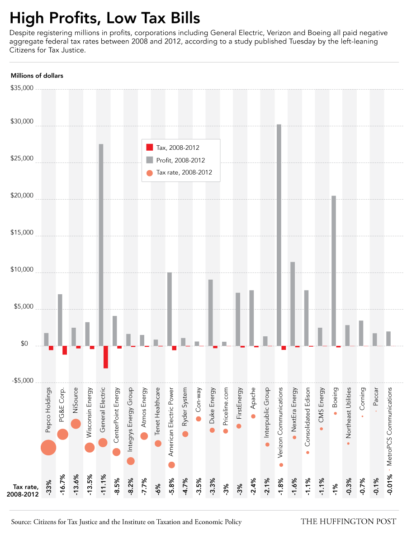
High Profits, Low Taxes

Slide 15
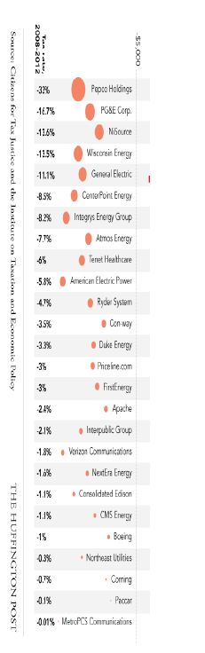

Slide 16
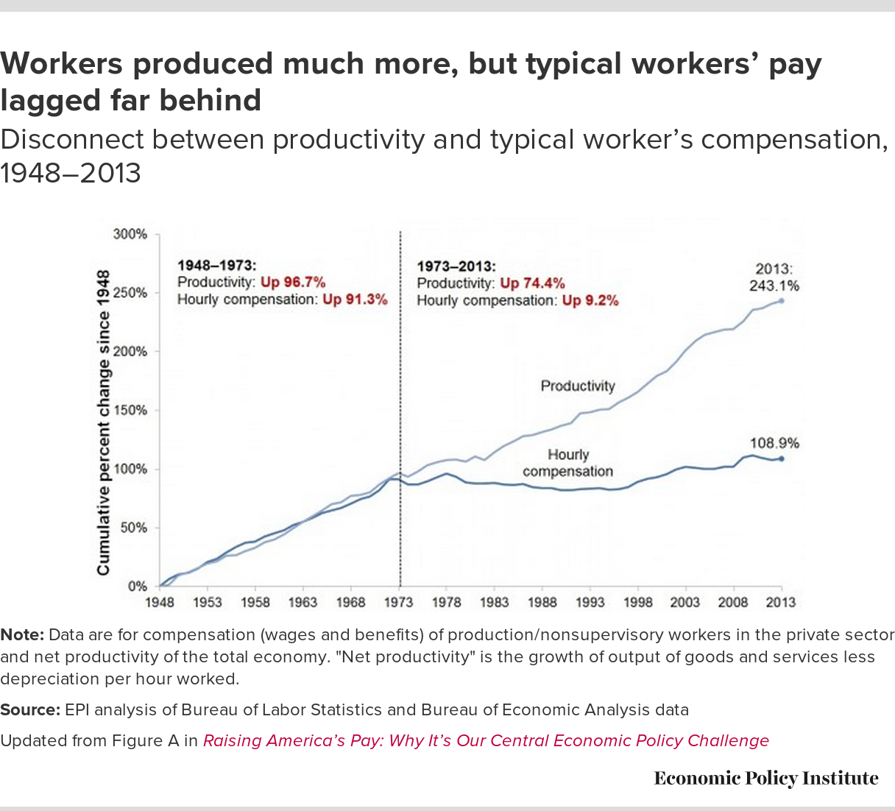
Wages and Productivity

Slide 17
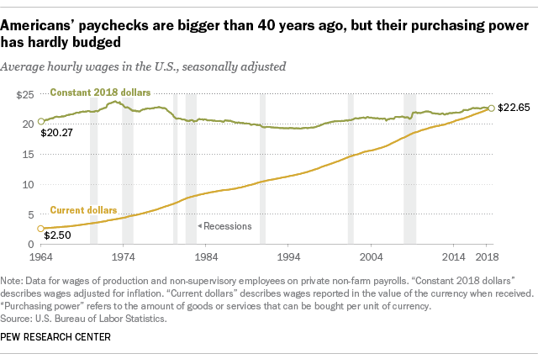
Purchasing Power and Hourly Wages

Slide 18
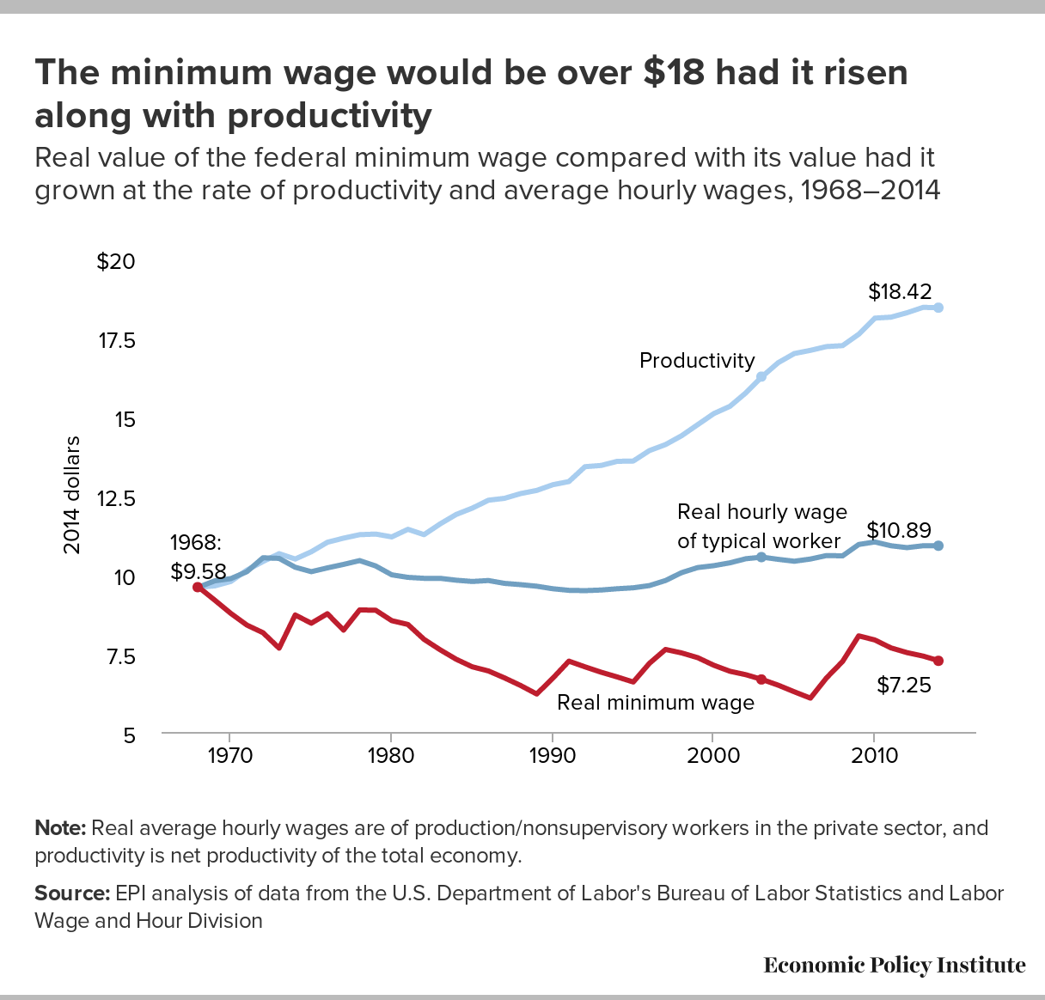
Minimum Wage

Slide 19
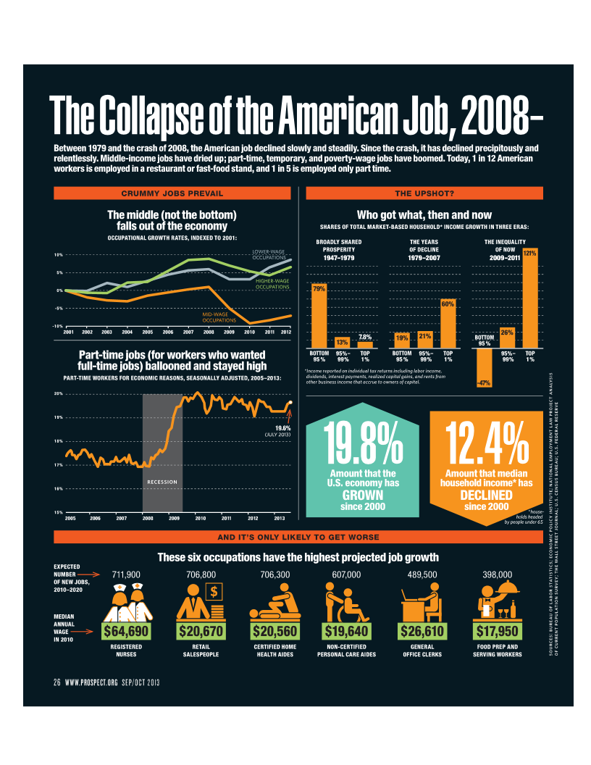
Occupational Growth Rates: The Hour Glass (indexed to 2001)

Slide 20
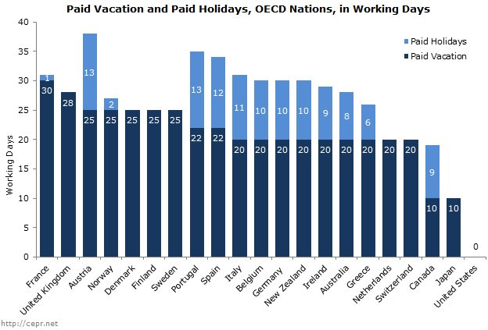
Working Harder
Notes:
Increased work hours to compensate for stagnate wages.

Slide 21
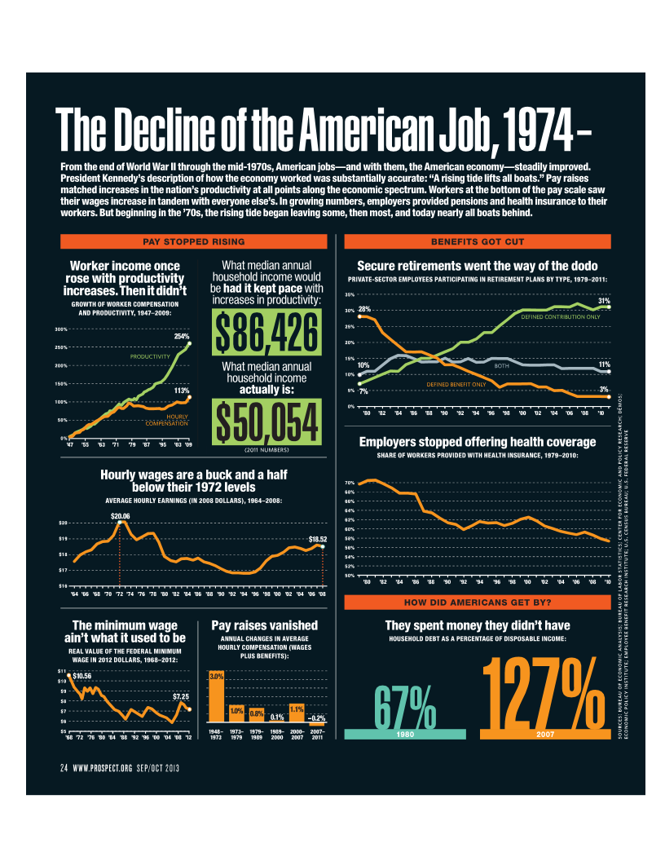
Benefits: Retirement and Health

Slide 22
By Comparison:

Slide 23
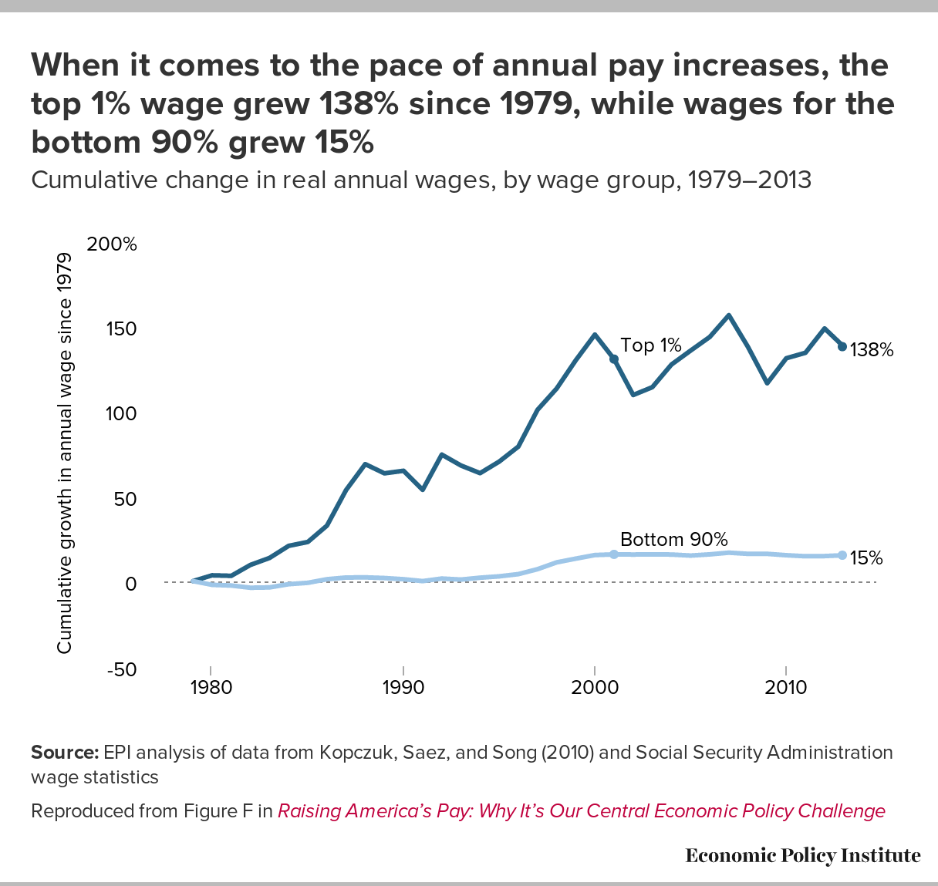

CEO Salaries have Skyrocketed:
http://www.youtube.com/watch?v=zbH66lGRfiI

Slide 24
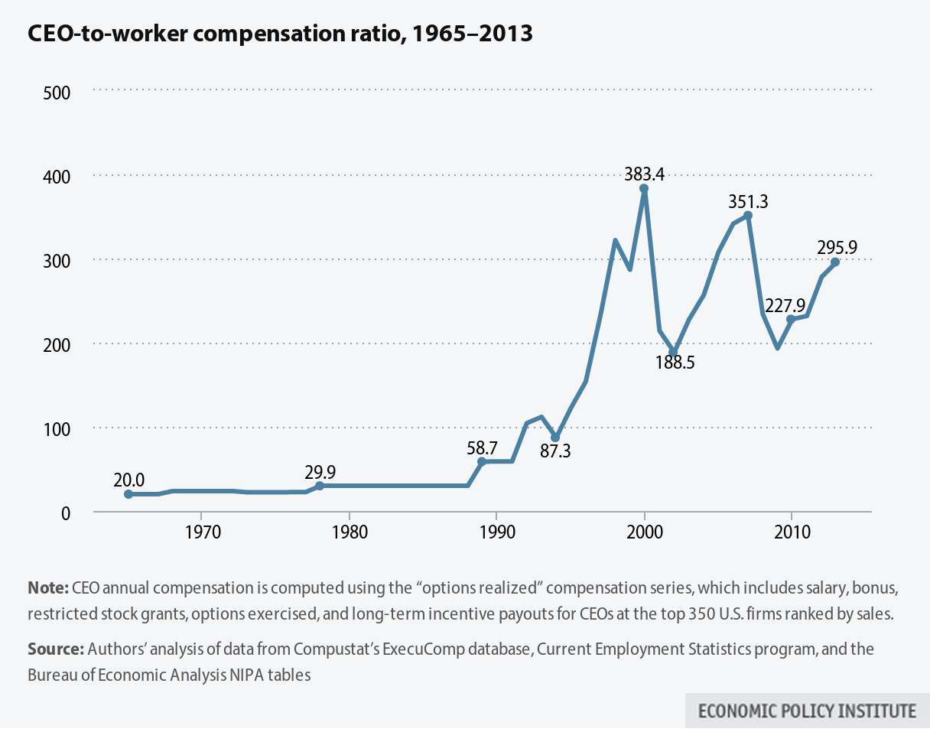
CEO to Worker Compensation Ratio: 1965-2013

Slide 25
Average CEO pay increased 14 % in 2011 and 8.8% in 2012 to a record $15.2 million in 2013 ($13.9 million in 2017), using a comprehensive measure of CEO pay that includes stock options, up 21.7% since 2010.
  Let’s take a CEO salary of $9.6 million:
  A minimum wage worker would have to work (in years) to make this:
  636 years.
  With a national median salary, $51,371, you would have to work (in years):
  187 years.
  If you assume the CEO works a 60-hour week, the pay comes to:
  $3,072.84 per hour, or $51.21 per minute.
  OR
  Oracle CEO Larry Ellison earned nearly $95 million 2013
  = $507.48/second
  What does this level of inequality mean for economic growth?

Slide 26
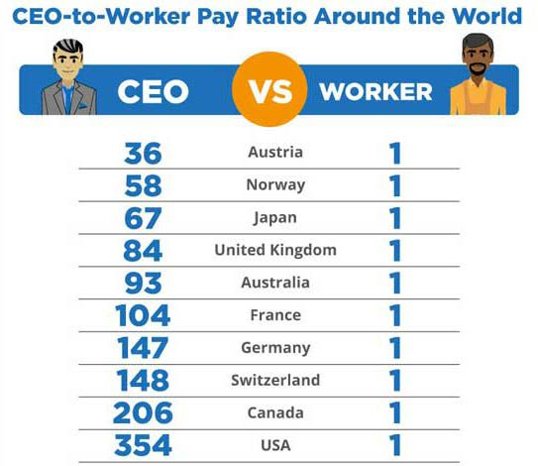
Global Comparisons:
https://aflcio.org/paywatch

Slide 27
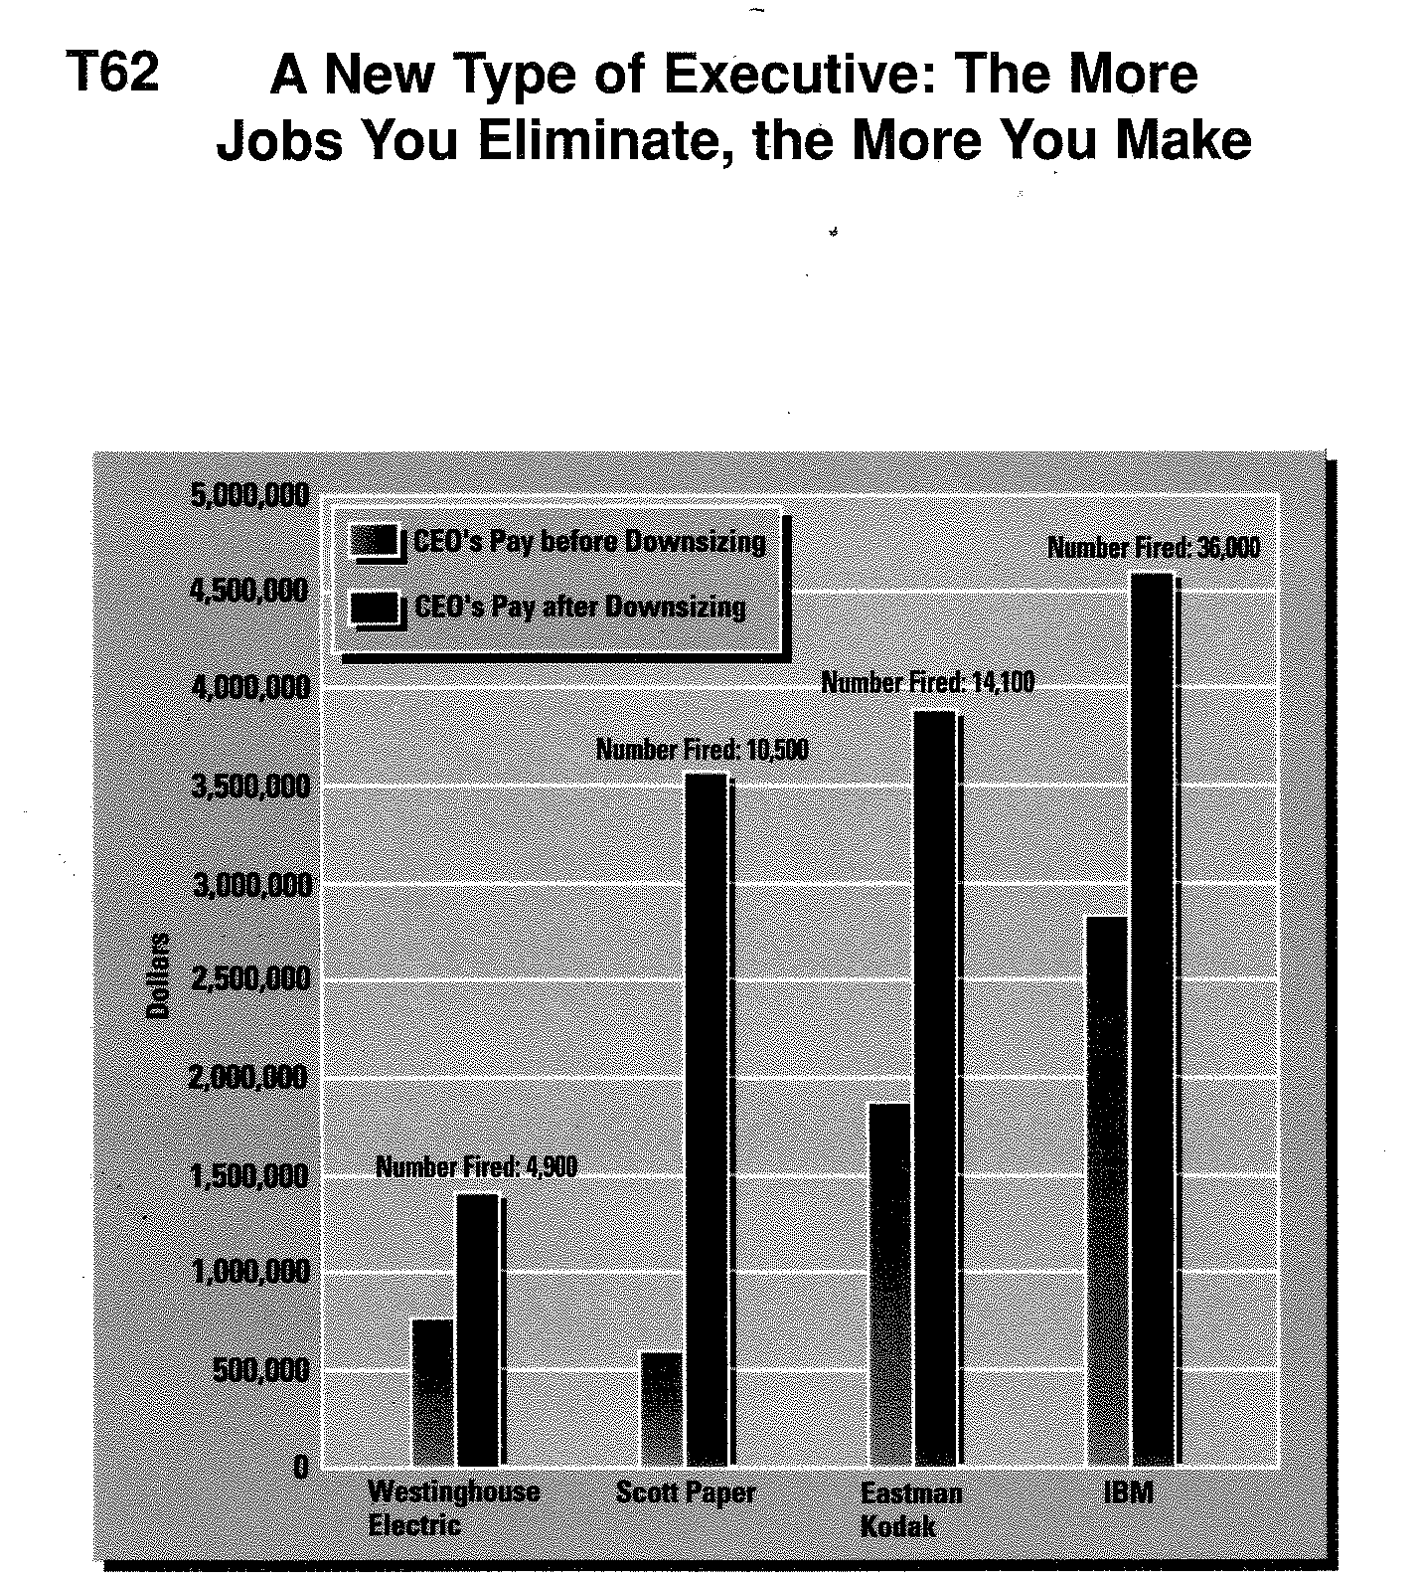
All CEO are Not Equal: Meet the New 1990s CEO

Slide 28
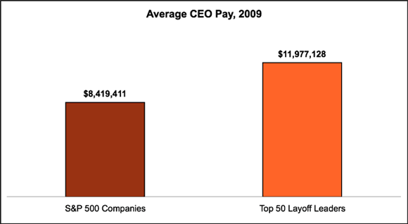
What’s Changed?

Slide 29
Distributional Trends:

Slide 30
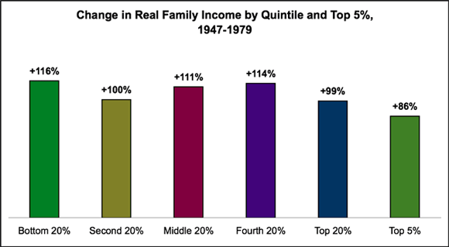

Slide 31
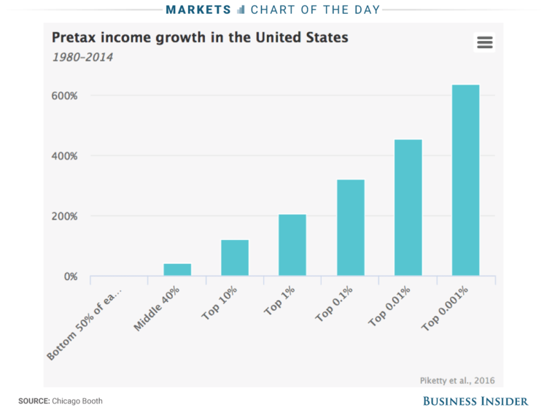

Slide 32
Share of Aggregate Income Received by Families by Class
Quintile | 1947 | 1950 | 1960 | 1970 | 1980 | 1990 | 1995 | 2000 | 2009 | 2015
Lowest | 5.0 | 4.5% | 4.8% | 5.4% | 5.3% | 4.6% | 4.4% | 4.3% | 3.9% | 3.7%
Second Third Fourth | 52.0 | 52.8 | 53.8 | 53.6 | 53.6 | 51.2 | 49.1 | 47.9 | 47.9 | 47.6
Highest | 43.0 | 42.7 | 41.3 | 40.9 | 41.1 | 44.3 | 46.5 | 47.7 | 48.2 | 48.6
Total | 100.0 | 100.0 | 100.0 | 100.0 | 100.0 | 100.0 | 100.0 | 100.0 | 100.0 | 100.0
Top 5% | 17.5 | 17.3 | 15.9 | 15.6 | 14.6 | 17.4 | 20.3 | 21.1 | 20.7 | 20.9
Middle Class
Source: U.S. Census Bureau; Historical Income Tables – Families.

Slide 33
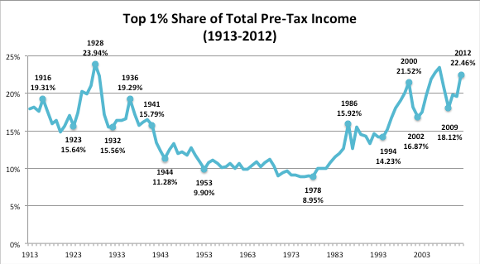
Top 1% (Families) Share of Pre-Tax Total Income

Slide 34
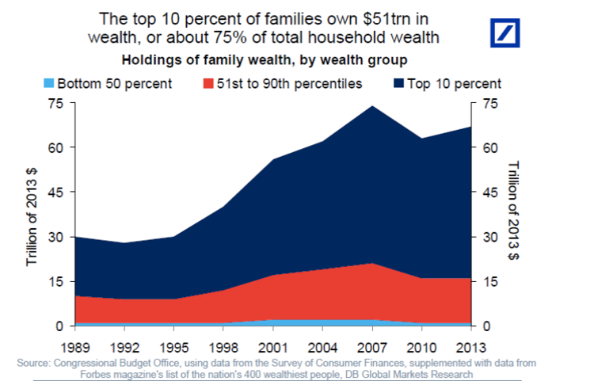

Slide 35
Union And Shared Prosperity in the US.
The divergence in income growth since 1979 corresponds with a decline in union influence;
http://www.youtube.com/watch?feature=player_embedded&v=QSYOedwIjMU

Slide 36
Effects of Neoliberalism: Conclusion
Declining workplace and product quality standards
Declining job security – from the “happy worker” to the “frightened worker”
Deteriorating benefits (medical insurance, pensions, and etc.)
Compensation lags productivity growth; erosion of the middle class
Subprime meltdown (over 12 million homes foreclosed on since 2007-racial, class and geographical dimensions)
Dramatic increases in inequality
Falling union density (both a cause and a consequence of the above trends)

